Slide 1
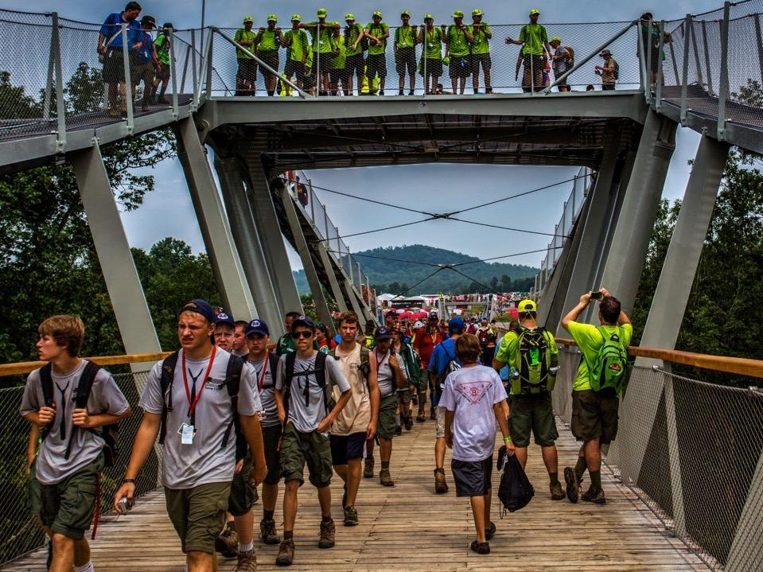
LIVE SCOUTING’S ADVENTURE
2017 NATIONAL JAMBOREE | JULY 19-28
Notes:
DC
Administrative note: The slides and Q&A questions answered will be available online on the HVC website after the event.
Please hold questions until after this presentation
The jamboree is the best of Scouting rolled into 10 days of fun, friends, and adventure, and you can be there to be a part of it!

Slide 2
ONE EXPERIENCE OF A LIFETIME
HUNDREDS OF ADVENTURES
TEN DAYS
Notes:
DC
The theme of the 2017 jamboree, “Live Scouting’s Adventure,” is a nod to what happens daily in packs, troops, teams, posts, ships, and crews nationwide.
It also reinforces one of the Summit Bechtel Reserve’s purposes of helping to redefine Scouting’s adventure for the next century. Participants of the 2017 National Scout Jamboree will experience that difference every day.

Slide 3
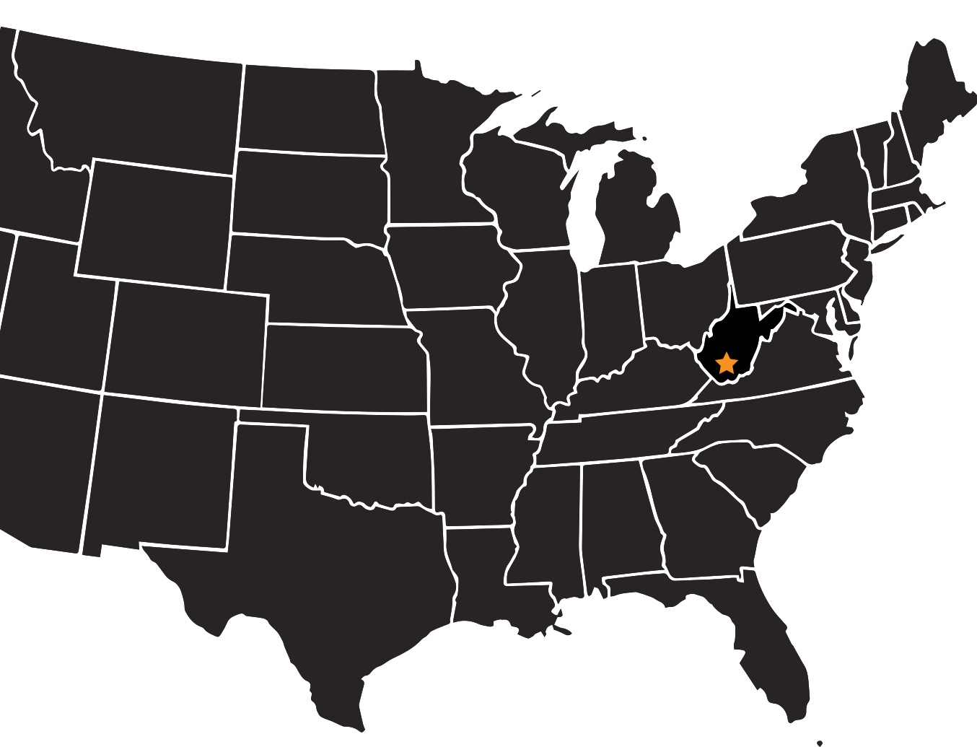
NEW RIVER GORGE AREA
WEST VIRGINIA
Notes:
DC
The 2017 jamboree follows on the heels of the wildly successful 2013 jamboree, the first jamboree at the Summit Bechtel Family National Scout Reserve in West Virginia’s New River Gorge region.
The 10,000-acre Summit Bechtel Reserve is adjacent to 70,000 acres of a federally protected national river area, one of the most amazing outdoor recreation centers on earth.

Slide 4
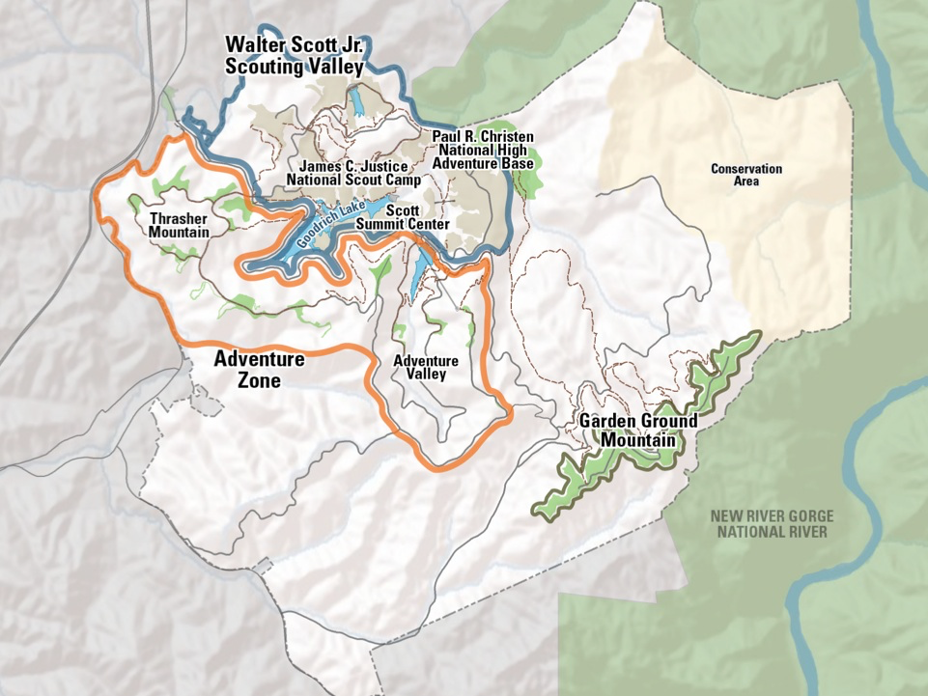
SUMMIT BECHTEL RESERVE
NEW RIVER GORGE AREA, WEST VIRGINIA
Notes:
DC
The 2017 National Scout Jamboree will be held at the Summit Bechtel Family National Scout Reserve. We’ll call it the “Summit Bechtel Reserve” from here on out.
More than 40,000 Scouts and Scouters will explore all kinds of adventures—stadium shows, pioneer village, Garden Ground hikes, adventure sports, patch trading, and more—in the heart of one of nature’s greatest playgrounds.
Once every four years, the national Scout jamboree brings generations together through Scouting’s biggest showcase. You won’t want to miss this amazing experience.
Basecamps will be your home away from home during the jamboree. There are four basecamps for Boy Scouts – Basecamps A, B, C, and D. Each basecamp has four subcamps that house around 2,000 participants each. Basecamp E is for staff, and Venturers and international Scouts will stay in Basecamp F.
The Summit Center, including Action Point, is where visitors will come to experience the jamboree with participants. Here, they'll get a taste of what the jamboree is all about.
One thing you may have heard is that the Summit was “not ready” for the 2013 Jamboree. Today I can assure you the Summit is absolutely “ready for us” for 2017. Facilities are more fully developed. Campsites are better groomed.
The Summit will also be host to the 2019 World Jamboree. If you’re a scout looking at possibly going to either National or World, bare in mind that World Jamboree will likely be twice as expensive and have *many* less spaces. It may be as few as 4-6 spaces for our council.

Slide 5
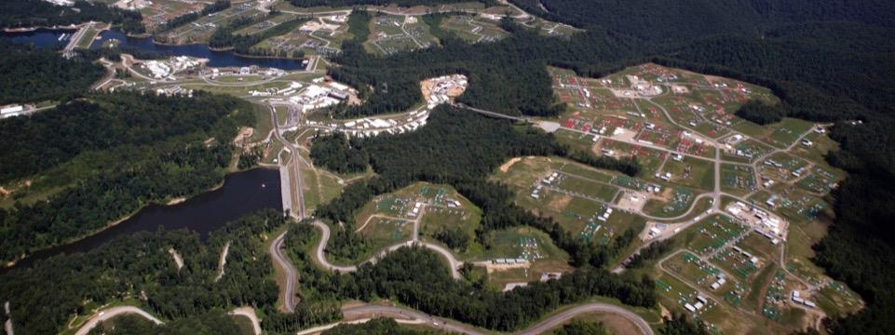
THIS IS
THE BEST OF SCOUTING
IN ONE PLACE
Notes:
SM
Our tradition of the jamboree delves deeply into what it means to be a Scout.
For over 75 years, the national Scout jamboree has brought members from all over the country and the world together to share the bond that is Scouting.
Each jamboree grows in numbers and in adventure, adding more and more activities for Scouts to turn into memories.

Slide 6
CLASSIC JAMBOREE EXPERIENCES
Notes:
SM
Enjoy some of the experiences that make the national jamboree an unforgettable experience:
Stadium shows
Patch trading
Day of service
Day of worship
Garden Ground Mountain hike
Merit badges
Camp life

Slide 7
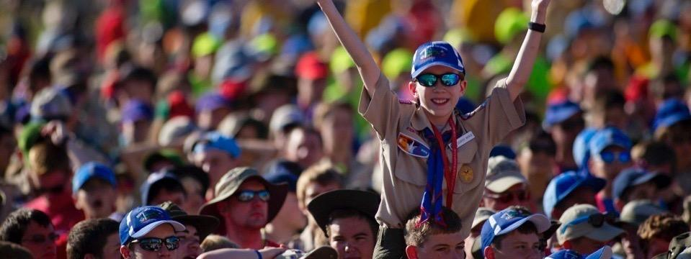
STADIUM SHOWS
Notes:
SM
Classic jamboree experiences form the foundation for your experience, and stadium shows at the AT&T Summit Stadium fit the bill. There’s nothing like seeing a sea of Scouts gathering to take it all in.

Slide 8
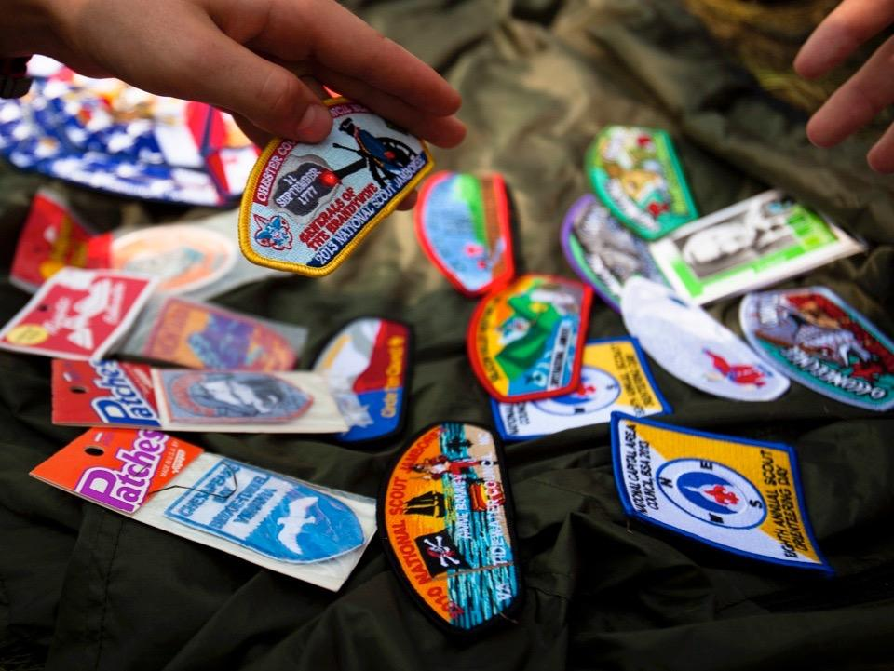
PATCH TRADING
Notes:
SM
Patch trading—It’s not just about scoring the coolest patches; it’s about meeting other Scouts from all over the United States and beyond.

Slide 9
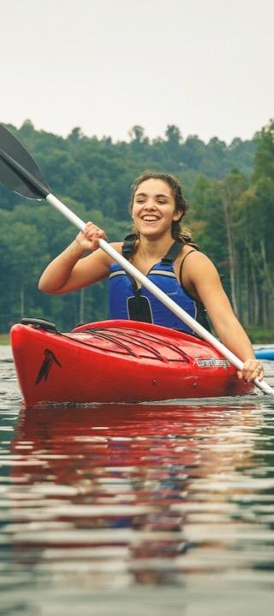
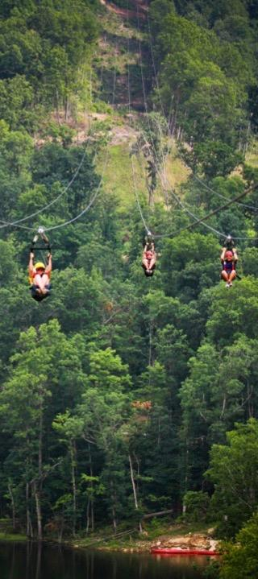
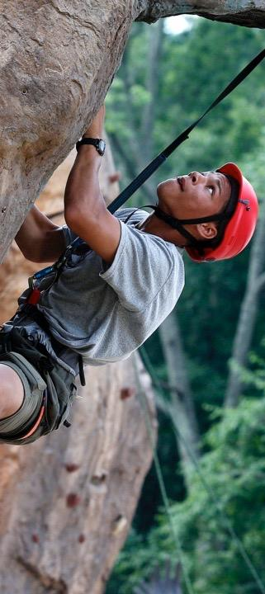
ADVENTURE SPORTS
Notes:
SM
The Summit Bechtel Reserve is home to some amazing adventure sport facilities. At the 2017 national jamboree, you’ll get a chance to try them out.
Try mountain biking, BMX, skateboarding, canopy tours, challenge course, zip lines, scuba, shooting and target sports, and touring kayaks.
For an additional fee you can try whitewater rafting.

Slide 10
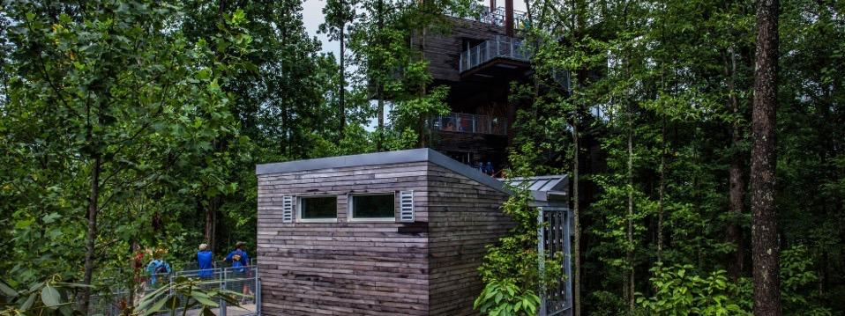
WALTER SCOTT
SUMMIT CENTER
Notes:
SM
Home of the Gateway Village, the Walter Scott Summit Center is the hub of the Summit Bechtel Reserve.
Here you can find 37 North outfitters store, merit badge opportunities, Action Point (tons of adventure sport activities), the CONSOL Energy Bridge, the Sustainability Treehouse, and all the Scouting you can handle!
You can also walk along the John Gottschalk boardwalk along Goodrich Lake, check out Boulder Cove (climbing and rappelling), and visit the exhibitors at Freedom Field.

Slide 11
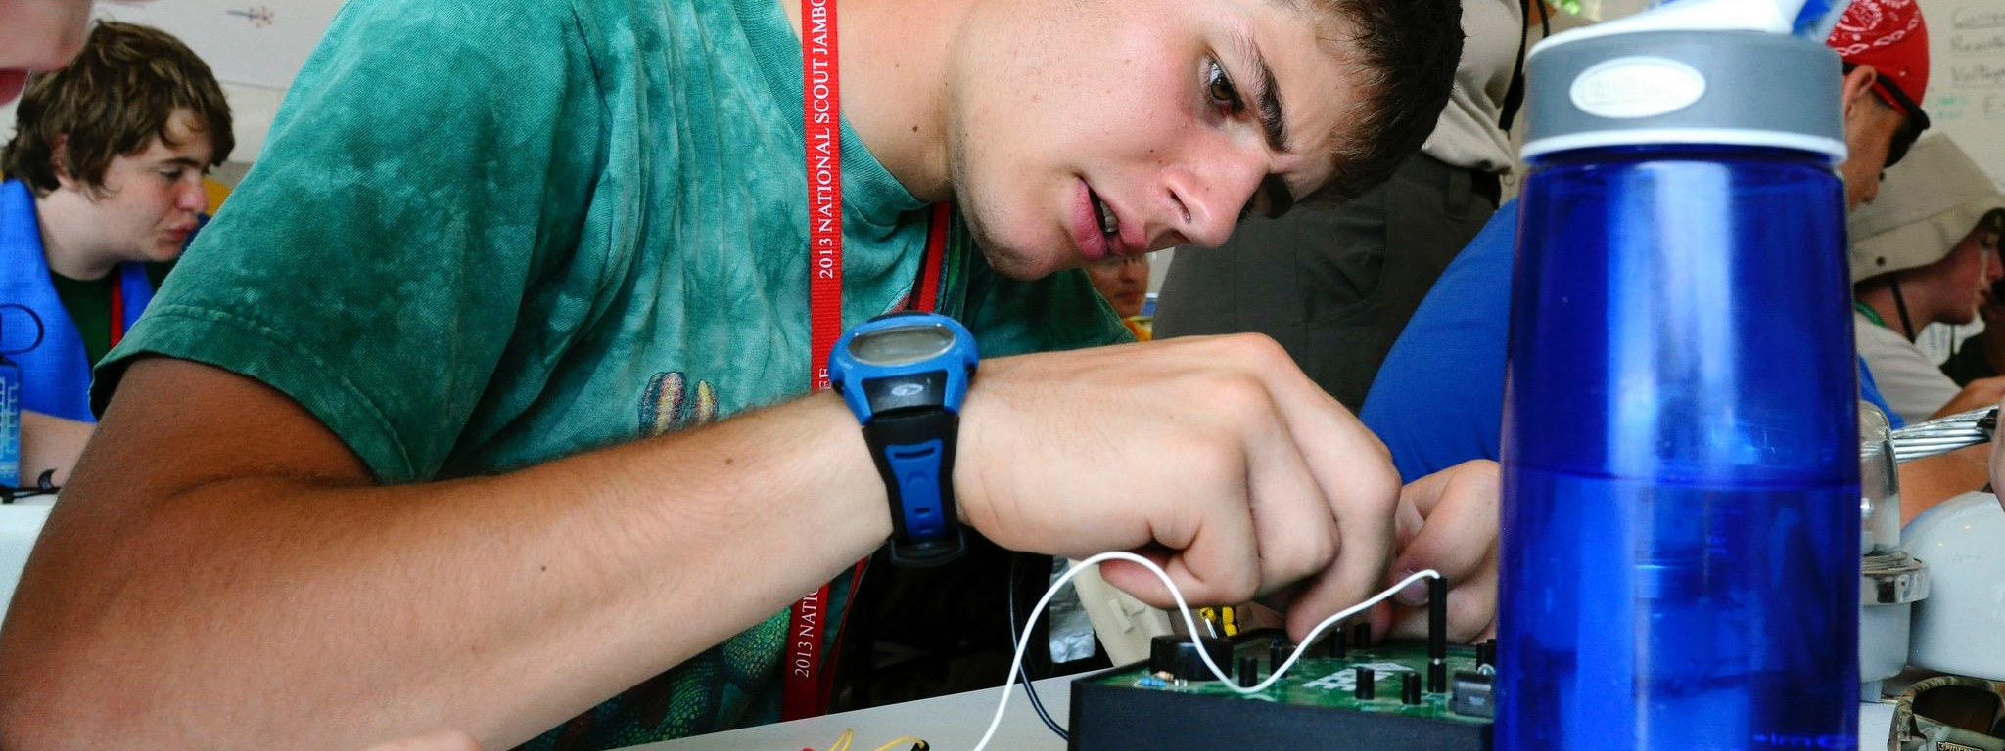
TECH QUEST
Notes:
SM
The science and technology experience at the jamboree is perfect for those Scouts seeking a different kind of adventure, one that puts their mind to the test and opens new frontiers of discovery.

Slide 12
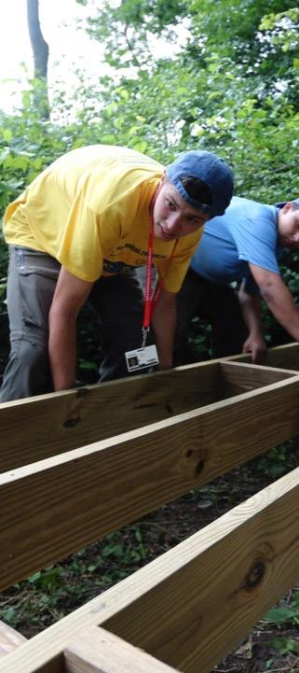
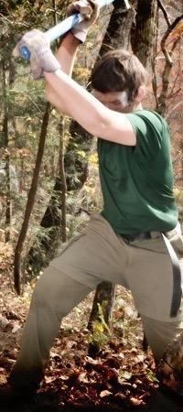
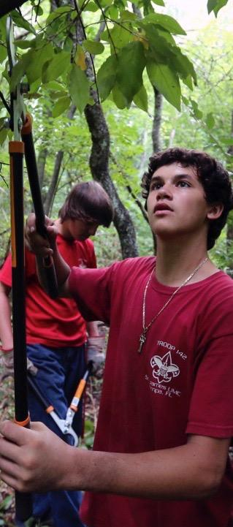
SERVICE
Notes:
SM
In 2013, 350 service projects were held in nine southern West Virginia counties totaling 300,000 service hours and a $3 million value of labor.
Join in the effort in 2017. You’ll not only help out area communities, but you’ll also learn skills and bond with your friends.

Slide 13
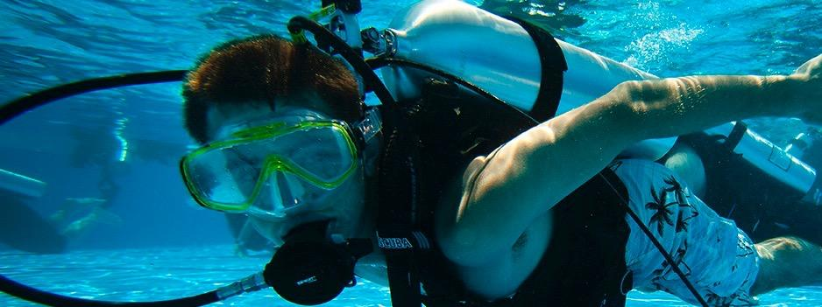
AQUATIC ADVENTURES
Notes:
SM
Touring kayaks, scuba, stand up paddleboarding, water obstacle courses, and more are a great way to cool off during your time at the Summit Bechtel Reserve.
Cool off at any one of four venues: Goodrich Lake East, Goodrich Lake West, Bravo Lake, and The Pools.

Slide 14
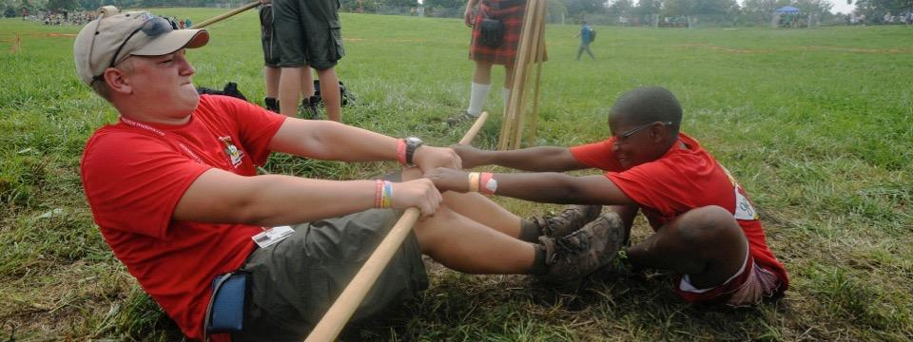
GARDEN GROUND
MOUNTAIN HIKE
Notes:
SM
Garden Ground Mountain Hike—Each Scout at the 2017 national jamboree will get to experience the buckskin games, Native American presentations, drumming, dancing, competitions, and bonfires during their full-day 3-mile trek to Garden Ground Mountain.

Slide 15
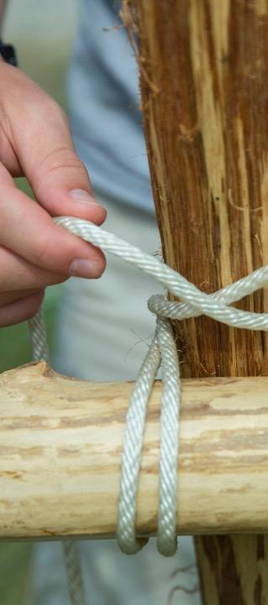
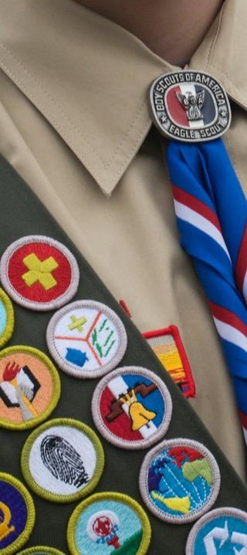
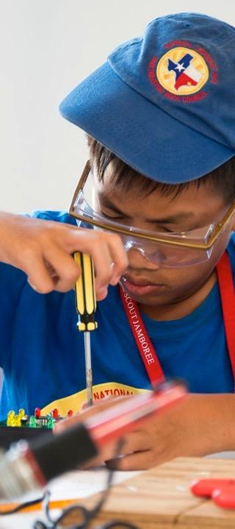
MERIT BADGES
Notes:
SM
Merit badges—Merit badge booths will be located throughout the Summit Center area of the jamboree. So you can get up to snuff on a ton of merit badges. You don’t need to sign up ahead of time; just show up and be prepared to learn and enjoy yourself in the process.

Slide 16
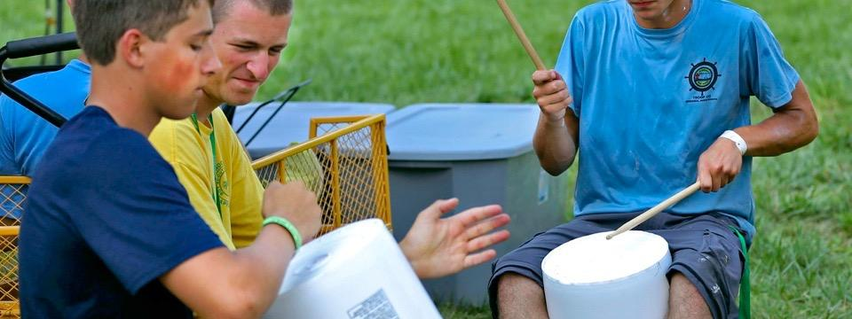
CAMP LIFE
Notes:
SM
Camp life—This is the backbone of the jamboree, the place where you work and play together with your fellow Scouts. From setting up camp on Day 1 to taking it all down on Day 10, this is your home away from home. Experiences like these strengthen units, solidify leadership, and forge friendships.

Slide 17
BE PREPARED
Scouts will...
Forming a Jamboree Troop / Crew
Develop relationships, unit leadership
Various training activities
Troops and crews will go do activities together
Patrol / crew activities
Hikes
Shakedown weekend
Notes:
DC
The Scout Motto is “Be Prepared.” And, well there’s a lot of things to do to be prepared for the Jamboree. Your role as Scouts will be to...
join a newly formed Jamboree Troop / Crew. You’ll essentially be a member of two units.
develop relationships, patrols, select leaders
various training activities
go on activities together like hikes and the shakedown weekend
Shakedown weekend will be a simulated jamboree experience here on our own turf so the troops and crews to prepare for the real thing.

Slide 18
GEAR UP
Jamboree will provide...
Tents, cots cookware, dining flies/areas, tools, etc
Council will provide...
Unit identification (numerals, CSP, flags)
Evaluating what other provisions will be provided
Scouts will provide...
Personal gear
Sleeping bag
Uniform/clothing
This is not an exhaustive or final list!
Notes:
DC
There’s a lot of equipment needed for the Jamboree. A lot of the equipment will be provided by the Jamboree. Some of what remains will be provided by the council. The rest will be left up to you.
Jamboree will provide tents, cots, cookware, dining flies, tools, etc
Council will provide unit identification (numerals, CSPs, flags, signage) and we’re evaluating what other provisions will be provided
Scouts will provide gear such as sleeping bag, uniforming, clothing, and personal needs
This is *not* an exhaustive or final list!

Slide 19
LEADERSHIP
Adult leaders are being selected by the committee
Leaders are currently active and well trained
For those adult applicants who are not selected to lead units, opportunities may exist to serve on unit committees later or to register as staff
Notes:
EH
Our scouts don’t get to the Summit on their own. There is a strong set of adult leaders responsible for each troop and crew.
Adult leaders are being selected by the committee
Leaders will be currently active and well trained
For those adult applicants who are not selected to lead units, opportunities may exist to serve on unit committees later or to register as Jamboree staff

Slide 20
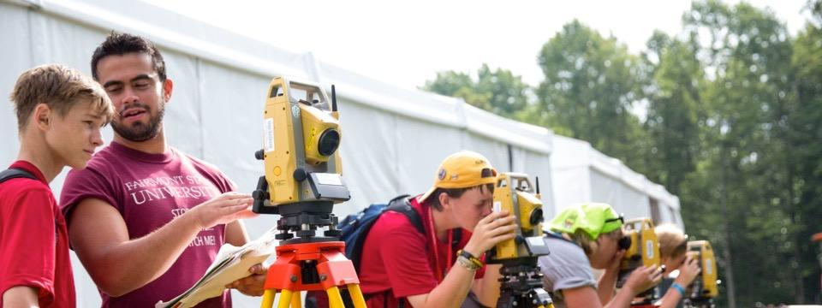
Enhanced Staff Transportation
Guaranteed Time Off
Better Communications
Enhanced Lunch Options
Pre-Selected Tent-Mates
Staff Village
Enhanced Showers
Laundry Service
Staff Photos
WHAT’S NEW FOR STAFF
IN 2017
Notes:
EH
Transportation—Staff transportation will be enhanced. Assuming a reasonable level of fitness, no staff member will be required to walk longer than 30 minutes between their place of lodging and their assigned work station.
Time off— Sufficient staff will be recruited and schedules developed to ensure staff members receive at least the equivalent of one full day off during the jamboree. Staff work hours will allow them the opportunity to visit and enjoy other areas of the jamboree outside their assigned work area. Provisions will be made for those desiring to explore the local area surrounding the jamboree during their day off.
Communications—A robust communications strategy will be developed and executed to keep staff members informed from the date they register as a staff member through the last day of the jamboree.
Lunch—We will make modifications to enhance the number and variety of lunch choices consistent with the requirement to maintain a “shelf stable” lunch menu given the demands of the site. We will provide supplemental items for our staff members in the more active program areas to ensure an appropriate level of caloric content for their anticipated level of activity.
Lodging—While capacity constraints of The Summit prevent the offering of two-person tent accommodations, staff members will be provided the opportunity to preselect their tentmates up to one month prior to the jamboree.
Staff Village—The staff village(s) will be designed to provide an area in which staff members can relax, recreate, and refresh themselves in the company of other staff members. Retail food and beverage stands will be incorporated in this design as well as an area for athletic competition.
Showers—We will explore options to increase water temperature; however, any solution will have to be consistent with our sustainability focus of conserving water and energy.
Laundry service—Laundry service will continue to be available for staff members desiring it.
Staff photos—Official staff photos of individual teams will be taken and staff members will have the opportunity to purchase photos of their choosing.

Slide 21
ELIGIBILITY
Boy Scouts
Current member
First Class Scout by first day of Jamboree
Age requirement
Participate in pre-jamboree training experience
Filed Jamboree medical record by April, 2017
Meet medical and body mass index requirements
Submit all fees according to the payment schedule
Complete Youth Protection Training before Jamboree
Notes:
NC
These requirements are set by the Jamboree - not locally at the council.
You must be a current, registered member of a troop
Advancement - Scouts must reach First Class before attending. You do *not* have to be First Class in order to register.
Age requirement - Be at least 12 years old by the first day of the jamboree or 11 years old and graduated from sixth grade, but have not reached their 18th birthday by the last day of the jamboree.
Pre-jamboree training - The training experience includes troop/crew activities including, but not limited to, the shakedown weekend.
Medical - No information is currently available on the process or procedure for completing the medical. However, in the past it was required to complete a physical within 12 months of the Jamboree. Plan your next annual physical accordingly.
Fees - Fees must be paid. If not paid, not getting on the bus.
Complete Youth Protection Training before the Jamboree

Slide 22
ELIGIBILITY
Venturing Scouts
Current member
Age requirement
Participate in pre-jamboree training experience
Filed Jamboree medical record by April, 2017
Meet medical and body mass index requirements
Submit all fees according to the payment schedule
Complete Youth Protection Training before Jamboree
Notes:
NC
These requirements are set by the Jamboree - not locally at the council.
You must be a current, registered member of a crew
Age requirement - Be at least 14 years old by the first day of the jamboree or 13 years old and graduated from eighth grade, but have not reached their 21st birthday by the last day of the jamboree.
Pre-jamboree training - The training experience includes troop/crew activities including, but not limited to, the shakedown weekend.
Medical - No information is currently available on the process or procedure for completing the medical. However, in the past it was required to complete a physical within 12 months of the Jamboree. Plan your next annual physical accordingly.
Fees - Fees must be paid. If not paid, not getting on the bus.
Complete Youth Protection Training before the Jamboree

Slide 23
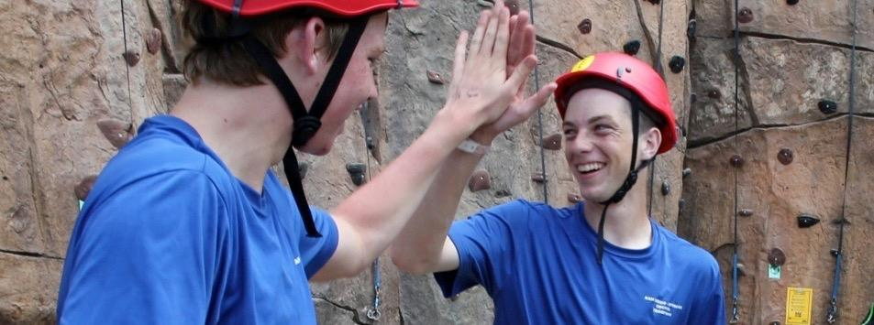
REGISTRATION IS NOW OPEN
YOUTH AND ADULT PARTICIPANTS
VISIT BSAJAMBOREE.ORG TO SIGN UP!
Notes:
NC
With everything that you’ve learned about the 2017 National Scout Jamboree, it’s possible that you’re left with just one question: “Where do I sign up?”
Registration is done electronically. Go online to bsajamboree.org and click on the Jamboree Registration button at the top right of the page or the button in the side menu to the right.
From there, you’ll just need to link your BSA membership to your Summit account. You need your last name, date of birth, and member ID number.
Upon completion of the application, print the “Request to Attend Form.” Parents, fill that out and take it to your local council to get the ball officially rolling!
Based on current registrations the council is currently planning on 2 troops and ¼ crew. That’s 72 Boy Scout and 8-9 Venturing spaces. Spaces are filling now and allocated at the time a deposit is made.
A waiting list will begin once the vacancies are taken. If the waiting list grows long enough another unit *may* be added.

Slide 24
COST
Cost includes
Buses
Lodging
Unit equipment
Training
Food
Jamboree admission!
Estimated cost: $1750
Scheduled payment plan already in place
Accepting payments today
Your deposit secures your spot in a troop / crew
Notes:
NC
Many of you might have been waiting for this slide…
We’re thrilled that you’re here today, expressing interest in registering for this once-in-a-lifetime event. It’s truly one of Scouting’s best adventures.
The cost for such an event isn’t cheap. There are many things to take care of… travel, lodging, food, equipment, training, and the Jamboree itself!
The estimated cost of the trip is $1,750. While that may seem initially expensive, the value of this trip makes it a bargain.
We are prepared, after the presentation today, to accept registrations and payments in the school cafeteria.

Slide 25
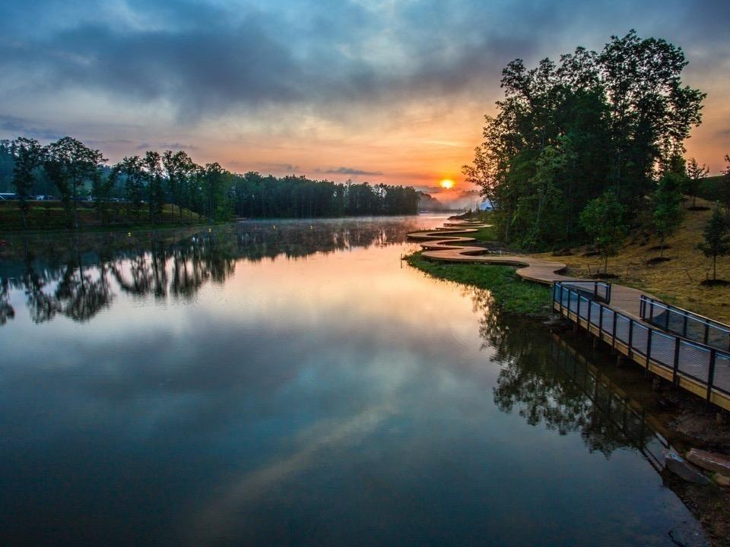
VISIT
BSAJAMBOREE.ORG
TO LEARN MORE AND REGISTER
Notes:
DC
Reminder: Slides and Q&A available on HVC site after the event. hudsonvalleyscouting.org/jamboree
You are now ambassadors of the message! Recruit your friends!!
Follow us on Facebook for pictures, information, and fun! facebook.com/hudsonvalleyjamboree
In the cafeteria we’ll have 4 lines…
Get BSA Id
Reg & pay w/ check
Reg & pay w/ credit
Reg without payment

